Slide 1
JAVA Lecture 21
JAVA Collections

Slide 2
What is the Java Collections Framework?
• A unified architecture for storing and manipulating groups of objects.
• Includes:
✅ Interfaces (e.g., List, Set, Map)
✅ Implementations (e.g., ArrayList, HashSet, HashMap)
✅ Algorithms (e.g., sort(), shuffle(), binarySearch())
✅ Utilities (e.g., Collections class)
✅ Part of java.util package.

Slide 3
Advantages of Using Collections
✅ Reduces need for custom data structures.
✅ Improves code readability and maintainability.
✅ Built-in type safety with generics.
✅ Performance-optimized implementations.
✅ Standardized APIs with rich methods.

Slide 4
Core Interfaces in the Collections Framework
Interface | Description
Collection | Root interface (parent of List, Set, Queue)
List | Ordered collection with duplicates
Set | Unordered collection with no duplicates
Queue | Supports FIFO structure
Map | Key-value pair collection (not part of Collection hierarchy)

Slide 5
Common Implementations
Interface | Class | Description
List | ArrayList | Resizable array, fast access
 | LinkedList | Doubly-linked list
Set | HashSet | No duplicates, unordered
 | TreeSet | Sorted set
Map | HashMap | Unordered key-value storage
 | TreeMap | Sorted key-value storage
✅ You choose based on need: order, performance, or duplication rules.

Slide 6
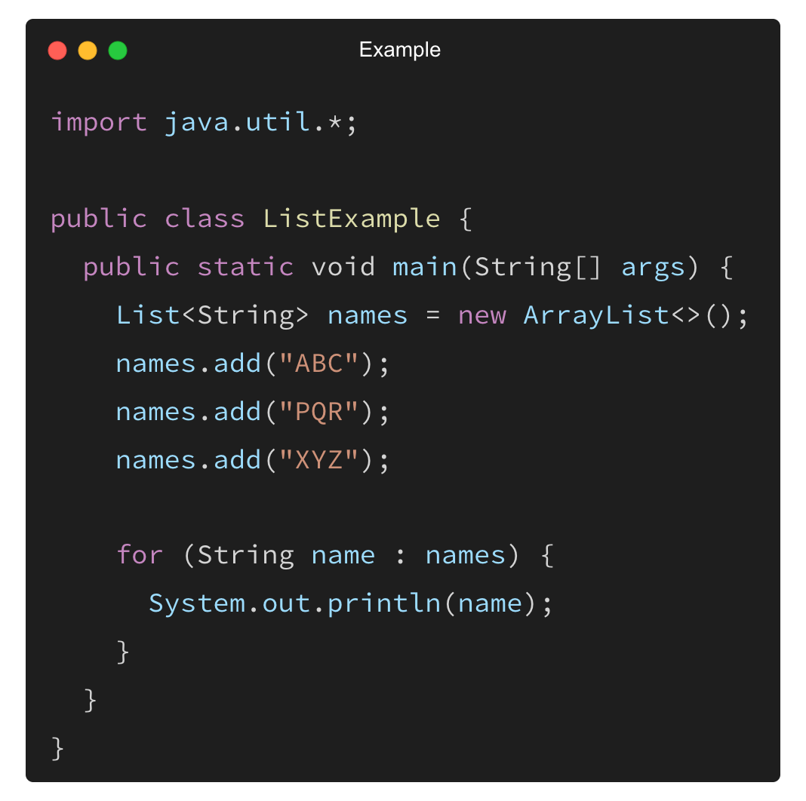
Example – Using a List
✅ ArrayList maintains insertion order and allows duplicates.

Slide 7
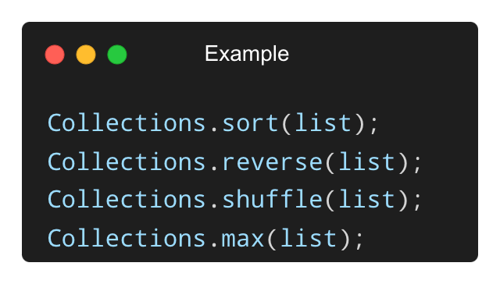
Collection Utilities – Collections Class
Provides static utility methods:
✅ Used for sorting, searching, reversing, finding max/min, and more.

Slide 8
When to Use Which Collection?
Scenario | Use
Need fast random access | ArrayList
Need unique items | HashSet
Need sorted keys | TreeMap
FIFO processing | Queue
Lookup by key | HashMap
✅ Choose based on use case for best performance.

Slide 9
Core Collection Interfaces
Interface | Description
Collection | Root interface for all collections
List | Ordered collection with duplicates allowed
Set | Unordered, no duplicates
Queue | For FIFO-style processing
Deque | Double-ended queue (insert/remove from both ends)
✅ These interfaces define the basic behavior collections must support.

Slide 10
Map Interface (Key-Value Storage)
Map<K, V> is a separate hierarchy for key-value pairs.
Does not extend Collection.
Allows fast lookup by key, no duplicate keys.
Common methods: put(), get(), remove(), containsKey()

Slide 11
Common Implementing Classes
Interface | Class | Key Feature
List | ArrayList | Fast access, resizable array
 | LinkedList | Fast insertion / removal
Set | HashSet | No order, no duplicates
 | TreeSet | Sorted elements
Map | HashMap | Fast lookup, no order
 | TreeMap | Sorted by key
✅ Select implementation based on order, sorting, and performance needs.

Slide 12
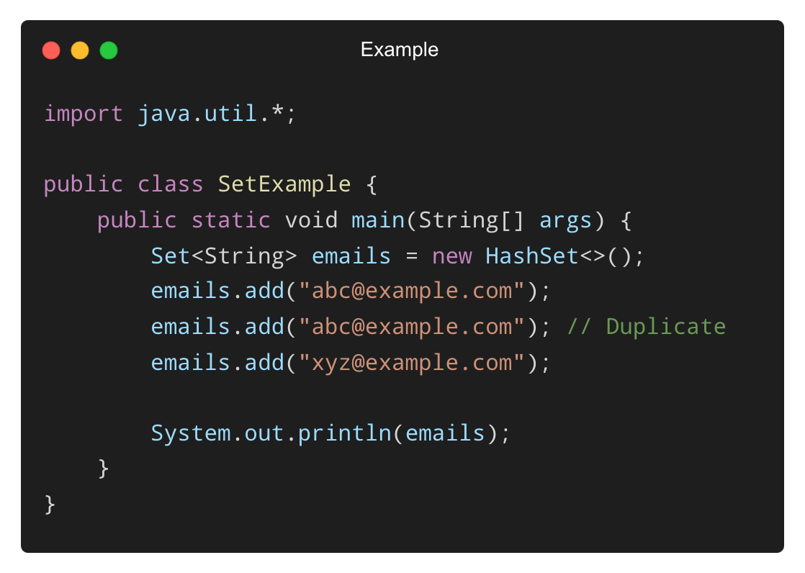
Example – Using a Set
✅ Output: abc@example.com, xyz@example.com (no duplicates)

Slide 13
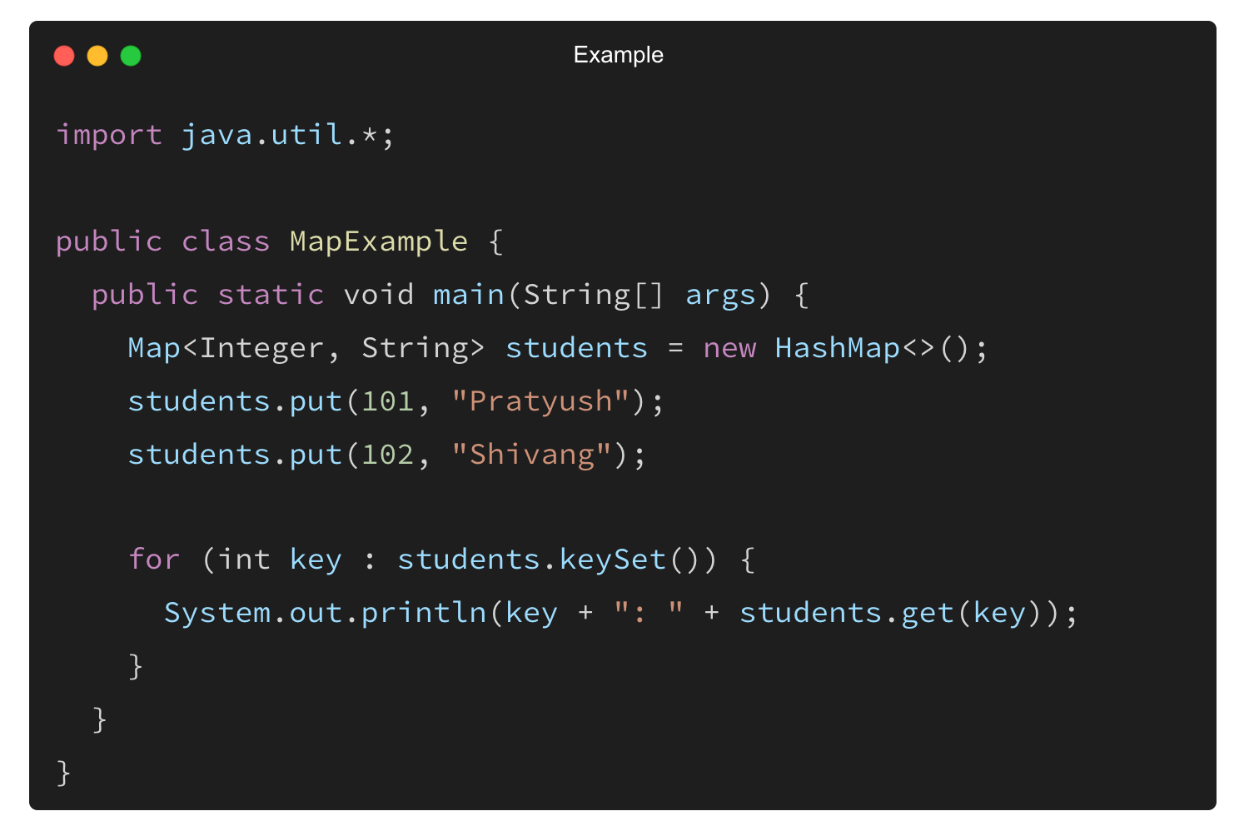
Example – Using a Map
✅ Maps allow quick lookup using keys.

Slide 14
Differences Between List, Set, and Map
Feature | List | Set | Map
Order maintained? | Yes | No | Keys: No (HashMap), Yes (TreeMap)
Duplicates allowed? | Yes | No | Keys: No, Values: Yes
Access method | Index | Element | Key
✅ Understanding these helps select the right data structure.

Slide 15
THANK YOU

